Slide 1
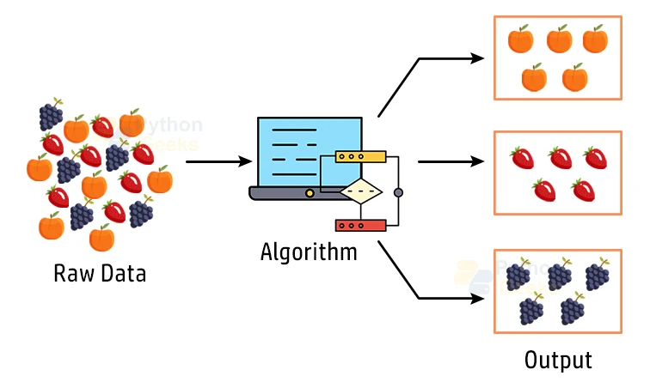
Unsupervised Learning (Clustering)
Finding Patterns in the Unknown
Instructor: Zaryab Ahmad Khan

Slide 2
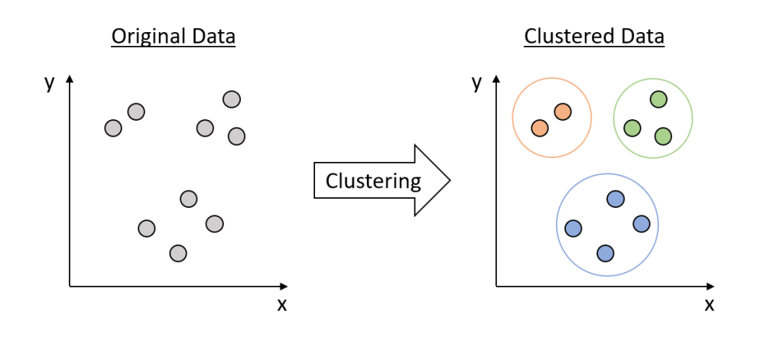
What is Clustering?
The Concept: Giving an algorithm data with no labels and asking it to group similar items together.
The Goal: Discovering hidden structures or natural groupings that a human might miss.
Analogy: Sorting a pile of mixed coins into groups based on their size and weight without knowing the value of each coin.

Slide 3
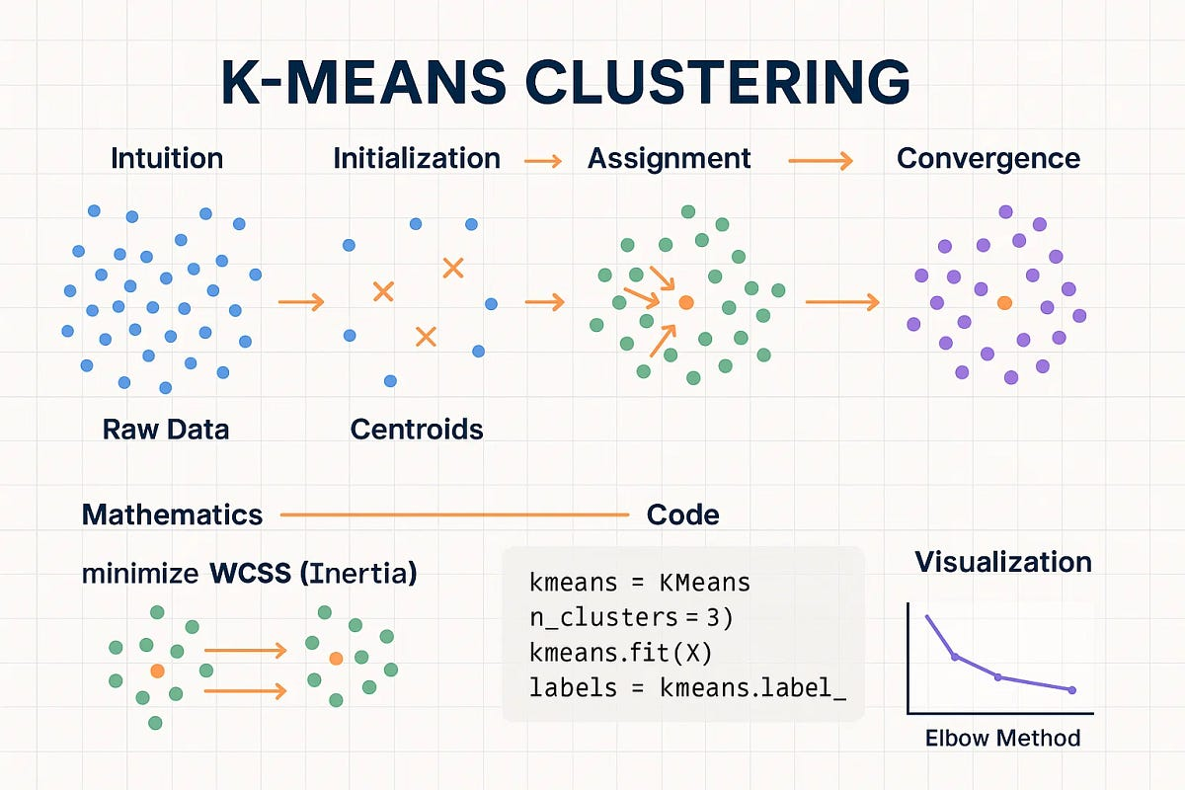
K-Means Clustering
Definition: An algorithm that splits a dataset into a specific number (K) of distinct groups.
How it Works:
The user chooses a value for K.
The algorithm places K "centroids" in the data.
Points are assigned to the nearest centroid, and centroids move until the groups are stable.
Real-World Use: Grouping store customers into tiers (e.g., Bronze, Silver, Gold) based on spending habits.

Slide 4
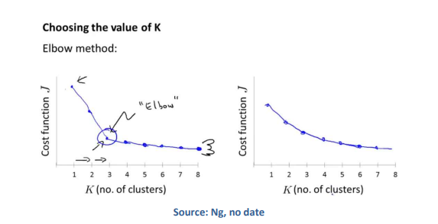
The Elbow Method
The Problem: How do we know if we should split our data into 2, 3, or 10 groups?
The Solution: A visual chart used to figure out exactly how many clusters (K) the data should be split into.
The Logic: We look for the "elbow" point on the graph where adding more clusters no longer significantly improves the grouping.

